Slide 1
Prevention Assessment Team
Julie Spedding 22/05/2025
ame

Slide 2
Who we are?
The Prevention and Assessment Team (PAT) is a collaboration of partners that share a common goal and vision, and that is to provide support to people when they need it, avoiding any unnecessary delays that may lead to a decline in an individual’s wellbeing or a worsening in their circumstances.
The Partnership is multi-disciplinary, with a range of accessible staff available to support both the person and also other professionals
West Sussex County Council – Community Prevention Officers
Sussex Community NHS Foundation Trust – Nurse Advisors
Age UK – Community Support Workers

Slide 3
What we do?
Undertake a whole system overview of the household and help identify what outcomes people want to achieve to enable their own and their carers independence, aiming to prevent/delay the need for more intensive services.
Provide information and advice to customers, their families and other professionals about what services, community resources and support are available to support to help retain independence.
Help people to access practical and emotional support through our end-to-end case work approach
Nurse advisor within the team offer more health focused advice and information.
Notes:
What is important to them – what has worked well, what has changed.
We refer people to the services they need with us staying with them through the process – avoiding unnecessary handoffs

Slide 4
Criteria
PAT can provide a service to people who are:
Aged 18 or over.
Able to act on the information, advice and guidance offered or someone within their network that can and will do so on their behalf.
Able to meaningfully participate in the process.
Able to benefit from an information, advice, guidance and signposting service

Slide 5
Health Prevention Offer
Supporting
People who have not seen their GP regarding their current non urgent health or wellbeing concern
People who have had recent falls, or have a fear of falling and have not received assessment, information and advice.
People would like information and advice regarding their health condition ,general wellbeing and medication management.

Slide 6
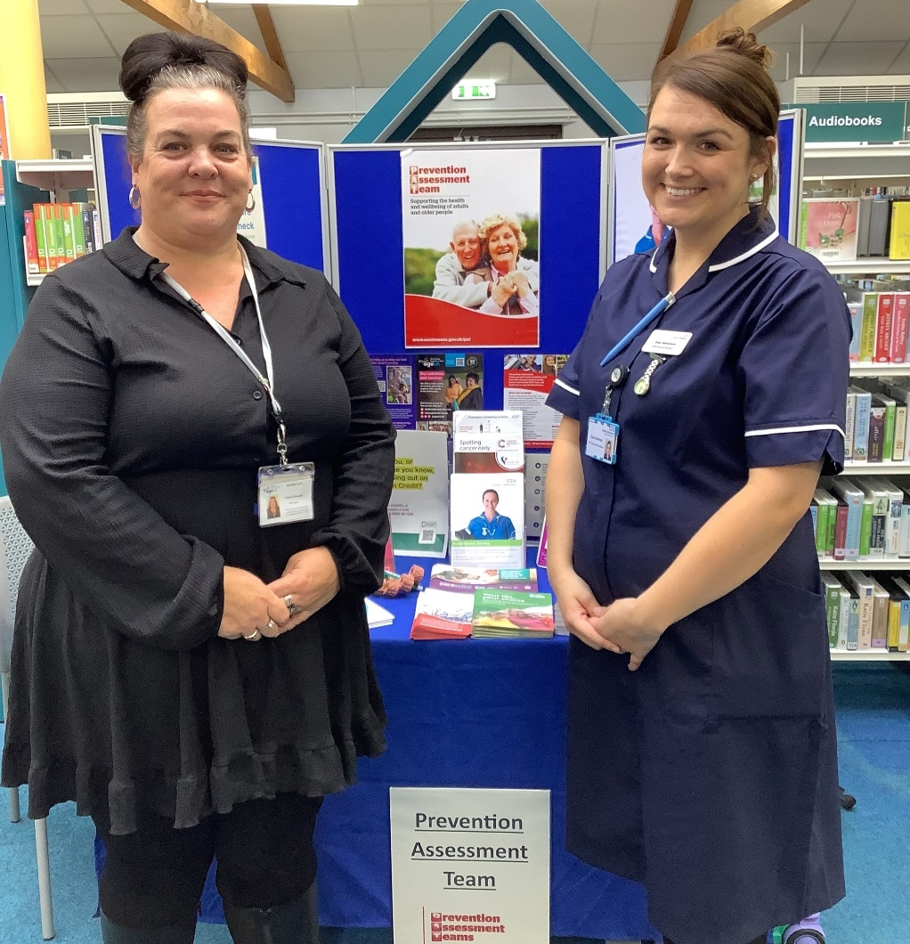
Other Health Services
NHS Health Checks for people aged between 40 and 74
Blood pressure/atrial fibrillation clinics for people over 18
Targeted events for early detection of hypertension and arrhythmias
Health promotion events on a rolling events calendar
Educational sessions for local community groups

Slide 7
Community Led Support
Embedding the Prevention Assessment Team in the community
Giving people information and advice, where they need it when they need it
Complementing existing services
Promoting PAT as widely as possible within the Community
Working in partnership with other services to support building a resilient community
Supporting people and organisations in understanding Adult Social Care Pathways

Slide 8
How do people get to us?
From Care Point
From Adult Social Care
Self-referral
Other professionals
Notes:
Care Point – if someones needs can be met via information, advice, signposting and referral
Adult Social Care – needs have been assessed as being able to be met via info etc
Self referral – promotions, talks etc – not so many given COVID restrictions
Other professionals – Fire Service for hoarding clutter. Health colleagues

Slide 9
Any questions?
Prevention Assessment Team 0330 222 4222
prevention@westsussex.gov.uk

