Slide 1






Carers Lead Learning Network Meeting

Slide 2
Overview
WSCC definition of a young carer
The team and their work
Young Carers Family Service - criteria & threshold
Young Carers Voices
Q&A

Slide 3
Who are the Young Carers?
A young carer is a young person under the age of 18 whose life is affected by the care needs of another person, who may have any disability or long-term illness.
This could be anybody with a physical or learning disability, mental health problem, long term chronic health condition, someone who misuses drugs or alcohol, or is elderly and frail.

Slide 4
Young Carers in Context
Young carers provide, or help to provide, a level of care and support to that person and take on a level of responsibility usually associated with an adult.
The person they care for is usually someone they live with and could be a parent, sibling, grandparent or other relative.

Slide 5

What might young carers be doing?
Practical tasks, such as cooking, housework & shopping
Emotional support, such as talking to someone who is distressed.
Physical care, such as helping someone out of bed, eat, drink
Looking after brothers and sisters.
Managing the family budget.
Personal care, such as helping someone dress, wash
Helping someone communicate.
Helping to give medicine/ collecting prescriptions.

Slide 6

The team
Operations:
Team Manager- David Brooks
Referral and Allocations Lead- Sherri Cleaver
Partnerships and Volunteering Projects Lead- Emma Capon
Referral Coordinator - Helen Byrne
Activity Programme Coordinator - Georgie Bean
Keyworkers:
Young Carers Mental Health Advisor - Serena Hall (Countywide)
Crawley - Jamie Brotherton
Worthing & Adur - Nicola Foord
Chichester- Amanda Trussler
Arun - Joely Irish
Horsham - Nicky Davies
Mid-Sussex - Sarah Cutler
Countywide - Alice Grace
Countywide - Russel Minns
Over 50 volunteers - including transport volunteers, group volunteers, activity volunteers, youth volunteers, volunteer mentors, micro volunteers, YCiS volunteers, panel volunteers
Notes:
9 Young Carer Family keyworkers across the county – one of whom has a mental health specialism

Slide 7
Our work
Statutory Young Carers assessments and Transition assessments
Whole family direct work – keyworker case work
Specialist mental health advisor
Consultation to other professionals
Equipment for Independence
Short Breaks Fund
Counselling, Art and Equine therapy
Regular groups and activity days
1:1 mentoring with a volunteer
Young Carers in Schools
Young Carers Panel
Raising awareness, training other professionals, developing resources

Slide 8
Young Carers Family Service – criteria & threshold
Criteria 1 - be under 18 and caring for an adult
The child/young person lives with, or has a significant level of contact with, a family member with a diagnosed disability or long-term illness which results in a caring role (physical, practical or emotional) which has a significant negative impact on the child/young person’s life
Criteria 2 - be under 18 and caring for a sibling(s)
The cared for sibling must have a formal diagnosis (referrals for siblings on a pathway or with an EHCP with no formal diagnosis will not be accepted)
The sibling carer must have significant caring responsibilities in relation to the cared for sibling Examples of this includes:
Physical care - lifting, feeding, washing, dressing etc
Emotional - witnessing recurring emergency medical interventions, regularly witnessing traumatic events, has a sibling with life-limiting illness
For a sibling carer who does not meet the criteria/threshold a “Sibling Carers resource pack” is available.

Slide 9
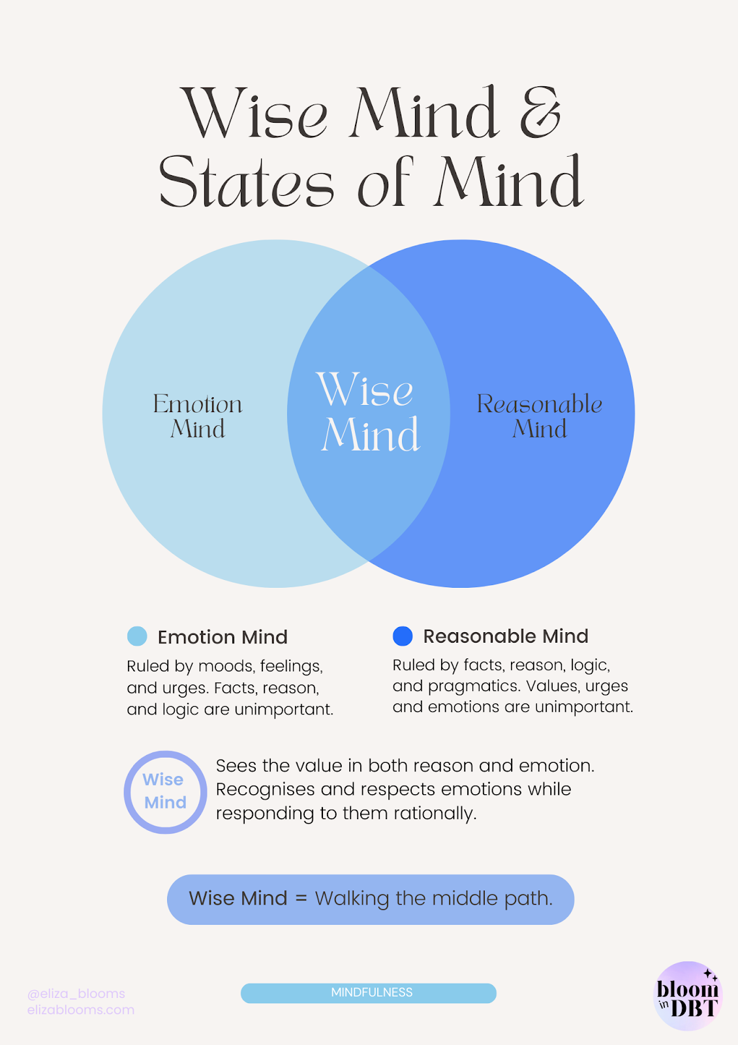
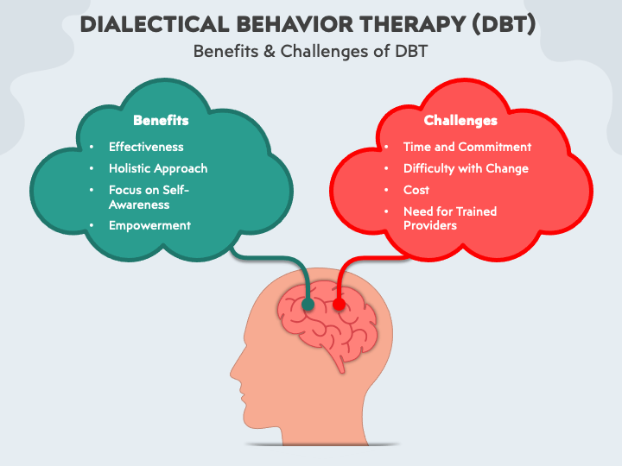
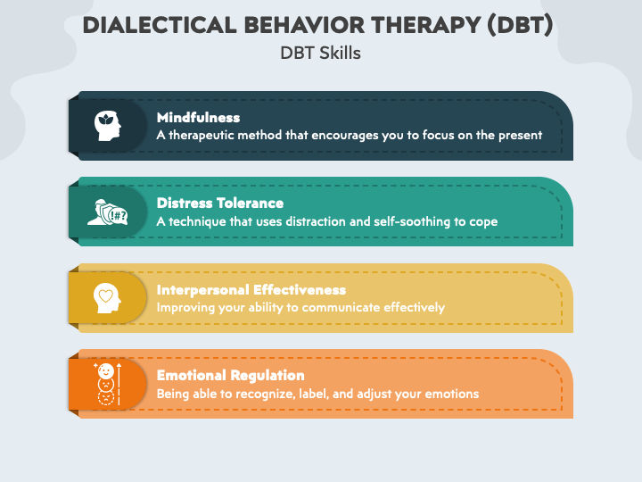
DBT “Dialectical behaviour therapy is an evidence-based psychotherapy that began with efforts to treat personality disorders and interpersonal conflicts. Evidence suggests that DBT can be useful in treating mood disorders and suicidal ideation as well as for changing behavioural patterns such as self-harm and substance use”.
Young Carers
Criteria 3 – Mental Health Advisor Support
Must meet at least criteria 1 or 2 in relation to their caring role
They would also need to meet one of more of the below:
Historic / current self-harm or self-injury – the young carer has caused harm to themselves in response to intense emotional pain, thoughts or feelings
Feelings or thoughts of suicide – the young carer has actively or has plans to take their own life / has disclosed thoughts around suicide
Has presented in A&E - are they a current risk to themselves?
al Health Advisor
(YCMHA)
Notes:
Dialectical Behaviour Therapy (DBT) is an approach to supporting people who struggle with managing their emotions and plan or have caused them self harm.
DBT works towards creating a wise mind where someone's emotional mind and reasonable mind can meet in the middle creating a wise mind – this can be described as accepting ill health and learning to live positively and still maintain a positive lifestyle
Its popularity has gained ground since the mid 1990s following successful research trials demonstrating its effectiveness.

Slide 10
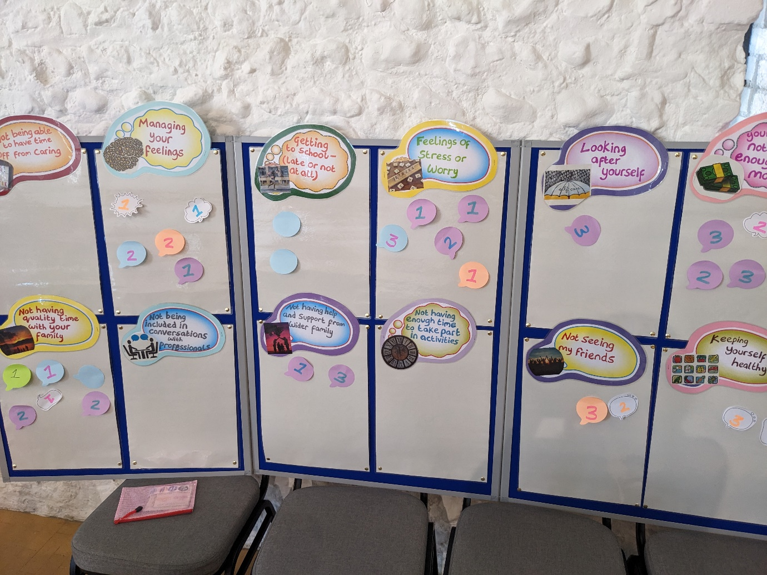
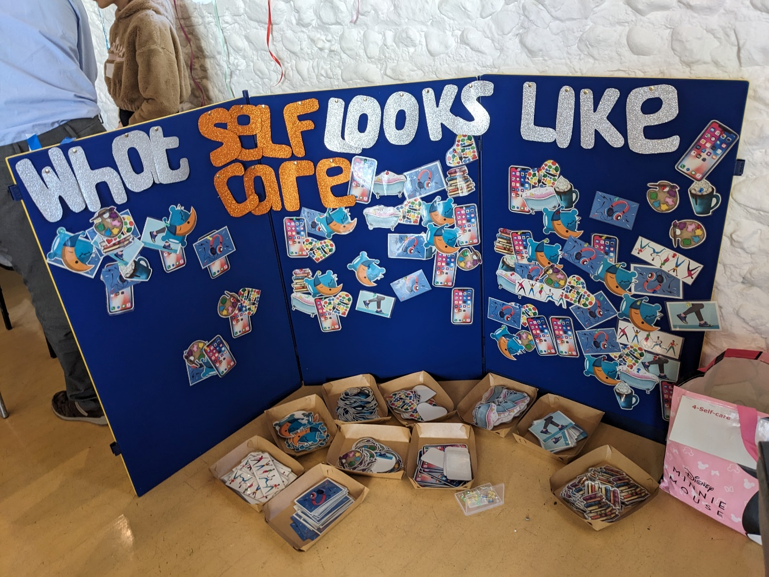
Young Carers Voices
Managing my feelings - stress and worry
Struggling to concentrate at school
My family not having enough money
On average it take 3 years for a Young Carer to be identified
and for a Young Carers assessment to be undertaken.
Not every young carer will need an assessment and not every
family will need additional support or a specialist service.

Slide 11
Contact details
Email: youngcarers@westsussex.gov.uk
Call: 01903 270300
Website:
https://www.westsussex.gov.uk/education-children-and-families/young-carers/

Slide 12
The support young carers said they most need:
Raising awareness about young carers so what I am doing to help out is recognised as soon as possible
Having a designated young carers person in school who I can speak to if needed
Having extra support when I move schools, move on to college or university or start work or leave home
More help for my family so I don’t have to do so much
Increased funding for a break so I can take part in activities outside of home
Notes:
Work in partnership with CSWx on GP resource, networking meetings etc
Delivering training and assemblies in schools across West Sussex, guidance and supporting schools to gain YCiS award
Training other professionals – Adult Social Care, Children’s Social Care, Early Help

Slide 13

Thanks for listening

