Slide 1

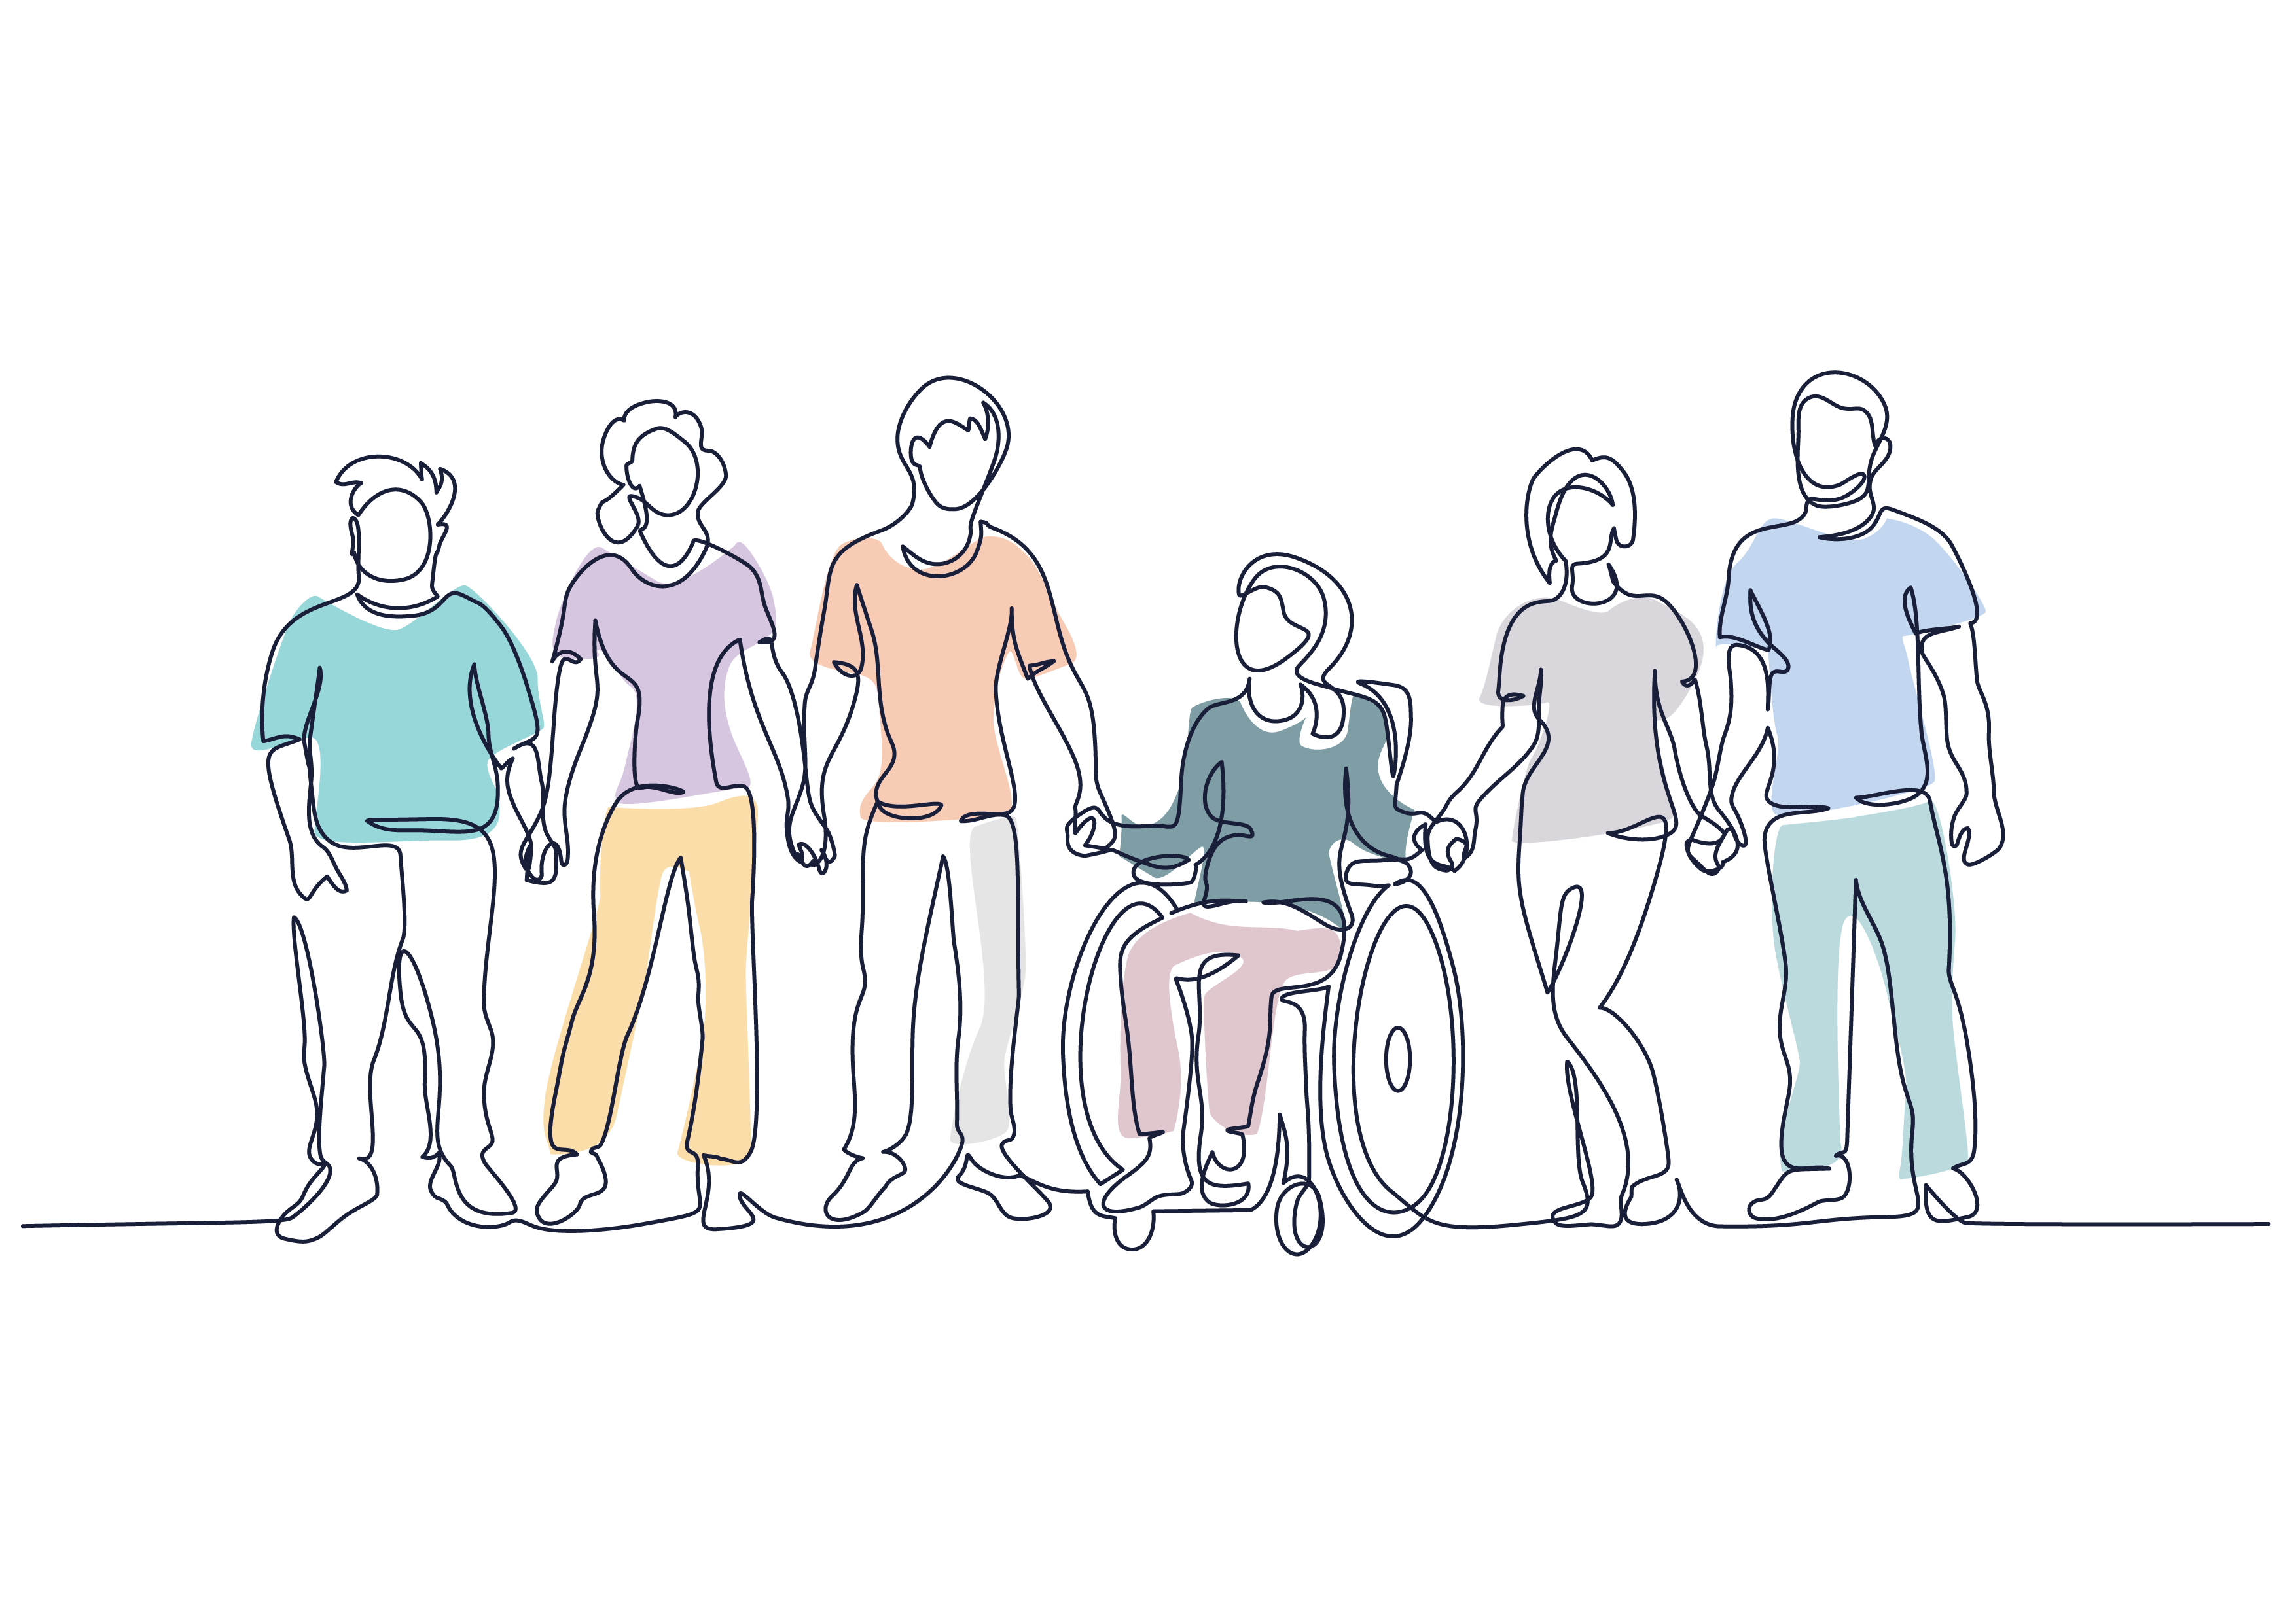
February 2020
Young Carers (0-17) and Young Adult Carers (16-25)
Notes:
Who are YCs & YACs
What caring responsibilities they may have
Impact of caring
Identifying young carers and young adult carers
Who to refer to

Slide 2
Definition: A young person who provides unpaid care and support to a family member or friend with an illness, disability, mental ill health or addiction.
Young Carers (0-17)
Young Adult Carers (18-25)
2021 ONS census reported that there are around 120,000 young carers aged 5-18 in England.
2024 school census suggested that there were 53,976 'known' young carers in the country.
2018 BBC survey found that there were as many as 820,000 young carers aged 11-15.
Who Are Young Carers & Young Adult Carers?
Notes:
Same definitions, for a young carer to young adult carer – the differences are in age & as they grow older the challenges they face may differ, especially when becoming more independent & exploring future aspirations.
To give some context... The 2021 census reported that there are around 120,000 young carers aged 5-18 in England, while the school census in 2024 suggested that there were just under 54,000 (53,976) 'known' young carers in the country. Then in 2018 the BBC did a survey and found that there were as many as 820,000 young carers aged 11-15.
So there are lots of different estimates and a lot of under reporting in schools of how many young carers & young adult carers there are across the country. But one thing is for certain: There are clearly a significant number of young people across the country with caring responsibilities, and it’s important that every one of them is getting the support they need.
Carers Trust has produced a breakdown of all of the data relating to the 2024 schools census is broken down by local authority, with West Sussex only reporting 1,010 YCs – which is massively less than the predicted 6,000 just within West Sussex alone.

Slide 3

A young carer or young adult carer may undertake some or all of the following:
Practical tasks: cooking, housework, shopping
Physical care: lifting, helping up the stairs
Personal care: dressing, washing, toileting needs
Household management: paying bills, managing finances, collecting benefits
Looking after siblings: putting to bed, walking to school
Supervision of medication: collecting medicines from pharmacies and making sure they are taken at the right time
Emotional support: listening, calming, being present
Who Are Young Carers & Young Adult Carers do?
Notes:
Same definitions, from a young carer to adult carer – the differences are in age & as they grow older the challenges they face may differ
Examples of caring responsibilities include:
Practical tasks such as cooking, shopping and housework
Physical & personal care
Emotional support
Managing finances or prescriptions
Helping with medication
Looking after siblings
Helping their cared for communicate – which is something you may see within GP surgeries.

Slide 4
Physical health: often severely affected by caring through the night, repeatedly lifting a heavy adult, poor diet and lack of sleep.
Emotional wellbeing: stress, worry, tiredness and mental ill health are common for young carers.
Isolation: feeling different or isolated from their peers, limited opportunities for socialisation.
Unstable environment: traumatic life changes such as bereavement, family break-up, losing income and housing, or seeing the effects of an illness or addiction.
Education: irregular attendance, poor timekeeping, lack of concentration, difficulties with homework
Restricted training/ employment choices: lack of time for personal development, poor flexibility in work practices.
Impact of caring
Notes:
If not properly assessed and supported, the effects of their caring responsibilities can be significant:

Slide 5
GP Surgeries and Primary Care Teams
Has a young person or young adult mentioned caring for someone at home?
Is there a long-term illness, disability, mental health condition or substance misuse issue within the family?
Is a young person regularly attending appointments with a family member?
Does the young person know a lot about a relative's medication, treatment or care needs?
Has the young person expressed concerns about a family member's health or support needs?
How many adults live in the family home?
Are you a GP seeing a parent who is chronically ill?
Are you supporting a young person with e.g.: anxiety/sadness/tiredness?
Does the patient need help with communication and understanding?
How might you know a young person is a carer?
Notes:
Here are some possible questions to consider and things to be aware of to help in identifying young people with caring responsibilities.
How many adults live in the family home?
To identify the support network within the household and assess whether caring responsibilities may be falling to a child or young person.
Does the patient need help with communication and understanding?
Again, to identify whether a child or young person may be providing support with communication, understanding, or navigating healthcare needs due to the patient's additional support requirements.
And to add when working with children and young people with additional needs or neurodivergence, be professionally curious about the wider family situation and exploring whether there are siblings at home who may be providing support or taking on caring responsibilities.

Slide 6

The young person must:
Be aged 0-17
Be caring for:
  An adult family member with health needs, or
  A sibling with a formal diagnosis and significant caring responsibilities
  Young carers - West Sussex County Council
Young Carers (Under 18) – Referral Pathway
Young Carers Referral Pathway (Short Version) Identify a child/young person under 18 who has caring responsibilities that are significantly impacting them. [Young Care...a Dec 2023 | Word] Check they meet Young Carers criteria (caring for an adult with health needs or a sibling with a formal diagnosis and significant care needs). [Young Care...a Dec 2023 | Word] Gain consent from the young person and parent/carer and discuss what support is needed. [Young Care...a Dec 2023 | Word], [YC Request...e May 2024 | Word] Complete the Young Carers Request for Service form, detailing the caring role, impact on the young person, family circumstances, and any mental health concerns. [YC Request...e May 2024 | Word] Submit the referral to youngcarers@westsussex.gov.uk. [YC Request...e May 2024 | Word] The Young Carers Team screens the referral against eligibility criteria. [Young Care...a Dec 2023 | Word] Outcome: Eligible → Assessment and Young Carers support offered. [Young Care...a Dec 2023 | Word] Not eligible → Signposting/resources provided where appropriate. [Young Care...a Dec 2023 | Word] Flow: Identify need → Check eligibility → Obtain consent → Complete referral form → Submit referral → Young Carers screening → Support or signposting.
Notes:
If the young person is under 18 they can be referred to the West Sussex Young Carers Family Service. The young person needs to meet the criteria of caring for an adult family member with health needs or a sibling with a formal diagnosis and significant caring responsibilities.

Slide 7
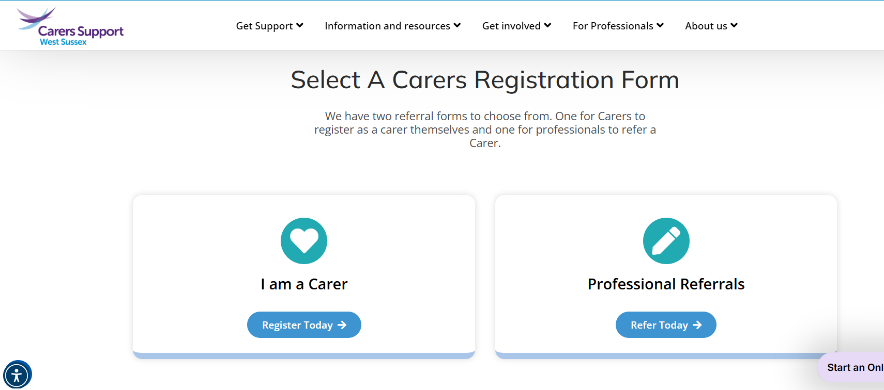
18+ can register with Carers Support West Sussex - https://www.carerssupport.org.uk/
Young Adult Carers (18-25)
Notes:
And if over 18, they can register with us at Carers Support – this can be a self referral if you signpost them to our website, or you can refer on their behalf with consent.

